Slide 1

Municipal Waste Collection Optimiser
Team No 31
E. Bhavyansh
2620030142
Gattu P Tridhama
2620030337
Yashwanth Rathan
2620030622
B. Sri Ram Deep
2620030605
Problem Solving Using Programming (Java) | 26SC1101E | PBL Project Review
Y26 I B.Tech, Section 6 | Faculty: P Swethanagasri
Notes:
Good morning ma'am. We are Team 31.
Our project is the Municipal Waste Collection Optimiser.
It is a Java console app that helps a city decide where garbage trucks are really needed each day.
We will show how we used all six COs in this one project.

Slide 2



Abstract
Most cities collect waste on a fixed daily route. Trucks visit every area, even when some bins are nearly empty while others overflow. This wastes fuel, time and money.
Our console-based Java application records the waste (kg) collected from each area for every day of the week. It classifies bins as LOW, HALF, FULL or OVERFLOW, ranks the areas, and builds a daily collection plan that skips low bins and counts the trucks needed.
Areas are modelled as Residential and Commercial objects with their own bin capacity and cost. Data is loaded from a CSV file, bad lines are handled with exceptions, reports are saved to a text file, and streams give quick insights such as overflowing areas and waste by area type.
11
menu features
6
course outcomes applied
5
classes and 1 interface
Notes:
In most cities, trucks follow the same route every day.
They go to every area, even when some bins are almost empty, while other bins are overflowing.
That wastes fuel, time and money.
Our app records how much waste each area produces on each day of the week.
It shows which bins are LOW, HALF, FULL or OVERFLOW, ranks the areas, and makes a daily plan that skips low bins and counts the trucks needed.
We also load data from a CSV file, save the report to a text file, and use streams for quick insights.
In total the app has 11 menu options, 5 classes and 1 interface, and it covers all 6 COs.

Slide 3



Understanding Problem Statement
Goal: use the waste data of each area to decide where trucks are really needed, instead of sending them everywhere every day.
Fixed routes
Overflowing bins
No data
Trucks visit every area daily, even half-empty ones, wasting fuel and time.
Busy areas like markets fill up first and are left unattended.
Supervisors cannot see which areas or days produce the most waste.
INPUT
PROCESS
OUTPUT
Area name and type, day,
waste in kg (keyboard or CSV)
Fill %, bin status, totals,
ranking, trucks, cost
Weekly report, collection
plan, insights, report file
Notes:
Our goal is simple: use real data to decide where trucks should go.
There are three problems we are solving.
One, fixed routes waste fuel. Two, busy areas like markets overflow first. Three, supervisors have no data to plan with.
The flow of our program is Input, Process, Output.
Input is the area, the day and the waste in kg, typed in or read from a file.
Process is the fill percentage, bin status, totals, ranking, trucks and cost.
Output is the weekly report, the collection plan, the insights, and a saved report file.

Slide 4





CO 1 Topics: Java Foundations
Course outcome: Translate a real-world problem into a precise algorithm and a working Java program using primitive types, expressions, and sequential console I/O.
CO1
Algorithm and IPO model
Input waste in kg, process fill %, output bin status
CO1 | data types, casting, Scanner
static final int TRUCK_CAPACITY = 1000;
public double fillPercent(int day) {
return (double) waste[day] * 100
/ getBinCapacity();
}
// round up without Math.ceil
int trucks = (load + TRUCK_CAPACITY - 1)
/ TRUCK_CAPACITY;
static int readDay() {
int d;
do {
d = readInt("Enter day number: ");
} while (d < 1 || d > 7);
return d - 1; // index starts at 0
}
Variables, constants, data types
int for kg, double for cost and %, String for names
Operators and expressions
Arithmetic, relational and logical (d < 1 || d > 7)
Type casting
(double) kg * 100 / capacity avoids integer division
Console I/O with Scanner
readInt() and readDay() read menu choice, day and kg
Notes:
CO1 is about turning a real problem into a Java program using basic data types and console input and output.
We use int for waste in kg, double for cost and fill percentage, and String for area names.
TRUCK_CAPACITY is a constant, so we declared it static final.
For fill percentage we cast to double. Without the cast, integer division would give a wrong answer.
To count trucks we round up using (load + 999) / 1000, so we don't need Math.ceil.
For input we use the Scanner class. readDay() keeps asking until the day is between 1 and 7, using relational and logical operators.

Slide 5




CO 2 Topics: Selection and Iteration
Course outcome: Design control flow using selection and iteration to solve problems requiring decisions and repetition, choosing the appropriate construct and reasoning about termination.
CO2
if, if-else-if ladder
getStatus() gives LOW / HALF / FULL / OVERFLOW
CO2 | if-else ladder, loop + continue
static String getStatus(double p) {
if (p > 100) return "OVERFLOW";
else if (p >= 80) return "FULL";
else if (p >= 40) return "HALF";
else return "LOW";
}
for (CollectionArea a : areas) {
if (getStatus(a.fillPercent(day))
.equals("LOW")) {
System.out.println("Skip " + a.getName());
continue; // no truck needed
}
load += a.getWaste(day);
}
switch with do-while
Menu of 11 options repeats until the user enters 0
while and do-while validation
Re-asks until the day or number entered is valid
Nested for loops
Prints the area x day table in the weekly report
break and continue
Stop search when found, skip LOW bins in the plan
Notes:
CO2 is about decisions and loops.
The getStatus() method uses an if-else-if ladder. Above 100 percent is OVERFLOW, 80 and above is FULL, 40 and above is HALF, and anything less is LOW.
Our main menu uses a do-while loop with a switch. It keeps running until the user enters 0.
We use while and do-while loops to check input, so the program never crashes on a wrong value.
Nested for loops print the table of areas and days in the weekly report.
In the collection plan, we use continue to skip areas whose bins are LOW, so no truck is sent there.
In the search, we use break to stop as soon as the area is found.

Slide 6



CO 3 Topics: Methods, Recursion and Arrays
Course outcome: Modularise solutions using methods and recursion, and store/process homogeneous data with one- and two-dimensional arrays, applying standard processing patterns.
CO3
Methods, parameters, return
fillPercent(), getStatus(), collectionPlan(day)
CO3 | overloading and recursion
static int getTotal(int[] row) {
int sum = 0;
for (int kg : row) sum += kg;
return sum;
}
static int getTotal(int[][] data) { // overloaded
int sum = 0;
for (int i = 0; i < data.length; i++)
sum += getTotal(data[i]);
return sum;
}
static int dayTotal(int[][] d, int day, int a) {
if (a == d.length) return 0; // base case
return d[a][day] + dayTotal(d, day, a + 1);
}
Method overloading
getTotal(int[]) for one area, getTotal(int[][]) for city
Recursion
dayTotal() adds one day across all areas, area by area
2D array
toMatrix(): rows are areas, columns are 7 days
1D array: sort and search
Bubble sort ranking, linear search by area name
Notes:
CO3 is about methods, recursion and arrays.
We split the work into methods like fillPercent(), getStatus() and collectionPlan(). Each takes parameters and returns a value.
getTotal() is overloaded. One version takes a 1D array and gives one area's total. The other takes a 2D array and gives the whole city's total.
dayTotal() uses recursion. It adds the waste of one area and then calls itself for the next area. The base case is when no areas are left.
The toMatrix() method builds a 2D array where rows are areas and columns are the 7 days.
To rank areas we use bubble sort, and to find an area we use linear search.

Slide 7

CO 4: Object-Oriented Design and Exceptions
Course outcome: Model a problem domain with classes and objects applying encapsulation and relationships, and make programs robust using Java's exception-handling mechanism.
CO4
Classes, objects, constructors
Overloaded constructors, this(...), objects made with new
<<interface>>
Reportable
<<interface>>
Comparable<T>
Encapsulation and static
private fields, getters/setters, static areaCount, toString()
<<abstract>>
CollectionArea
Inheritance and abstraction
Residential and Commercial extend abstract CollectionArea
- name : String
- waste : int[7]
+ getBinCapacity() : int (abstract)
Interfaces and polymorphism
Reportable, Comparable; overridden shortReport() and rates
ResidentialArea
CommercialArea
Exception handling
Custom InvalidWasteException, throw/throws, try-catch
500 kg bins, Rs 2.5/kg
800 kg bins, Rs 3.0/kg
Notes:
CO4 is about object-oriented design and exceptions.
CollectionArea is an abstract class. Its fields, name and waste, are private, and we access them through getters and setters. This is encapsulation.
It has two constructors, and one calls the other using this().
ResidentialArea and CommercialArea extend it. Residential bins hold 500 kg at 2.5 rupees per kg. Commercial bins hold 800 kg at 3 rupees per kg.
Each class overrides getBinCapacity() and getCostPerKg(), so the same code gives the right answer for each type. This is polymorphism.
The class also implements two interfaces, Reportable and Comparable.
We made our own exception, InvalidWasteException. setWaste() throws it if the waste is negative or too large, and we catch it with try-catch and ask again.

Slide 8


CO 5: Strings, Sorting and File I/O
Course outcome: Process textual data with the String/StringBuilder APIs, apply standard library algorithms (searching, sorting, comparison), and persist data using file input/output.
CO5
String methods
trim, toLowerCase, equalsIgnoreCase, contains, matches, join
CO5 | reading waste_data.csv safely
try (BufferedReader br =
Files.newBufferedReader(path)) {
String line;
while ((line = br.readLine()) != null) {
String[] p = line.trim().split(",");
try {
int kg = Integer.parseInt(p[2].trim());
...
} catch (NumberFormatException
| InvalidWasteException e) {
System.out.println("Line skipped: "
+ e.getMessage());
}
}
} catch (NoSuchFileException e) {
System.out.println("File not found");
}
StringBuilder report
buildWeeklyReport() is shared by screen and file output
Parsing with split()
Each CSV line is split(",") and parsed with parseInt()
Library sorting
Comparable compareTo() with Collections.sort() for top 3
File I/O and exceptions
BufferedReader/Writer, try-with-resources, multi-catch
Notes:
CO5 is about Strings, library sorting and files.
We use String methods like trim, toLowerCase, equalsIgnoreCase and contains. For example, if you search "kuk", the app asks "Did you mean Kukatpally?"
The weekly report is built with a StringBuilder, so the same text can be shown on screen and saved to a file.
Option 2 reads waste_data.csv line by line using BufferedReader. Each line is split by commas and the numbers are read with parseInt.
If a line has a bad value, like "abc", we catch the error, skip that line and keep going.
We use try-with-resources, so the file closes on its own.
For sorting we use Comparable with Collections.sort to get the top 3 areas.
Option 11 saves the report to weekly_report.txt using BufferedWriter.

Slide 9

CO 6: Collections, Lambdas and Streams
Course outcome: Manage collections of data and express data processing declaratively using the Collections framework, lambdas, functional interfaces, and Stream pipelines.
CO6
List, Map and Set
ArrayList of areas, HashMap for lookup, TreeSet for A-Z names
CO6 | smartInsights()
Predicate<CollectionArea> overflowedOnce =
a -> IntStream.range(0, 7)
.anyMatch(d -> a.fillPercent(d) > 100);
List<String> overflow = areas.stream()
.filter(overflowedOnce)
.map(CollectionArea::getName)
.collect(Collectors.toList());
Map<String, Integer> byType = areas.stream()
.collect(Collectors.groupingBy(
CollectionArea::getType,
Collectors.summingInt(
CollectionArea::getWeeklyTotal)));
Optional<CollectionArea> top = areas.stream()
.max(Comparator.comparingInt(
CollectionArea::getWeeklyTotal));
Generics
List<CollectionArea>, Map<String, Integer> keep data type-safe
Lambdas and functional interfaces
Predicate checks overflow, Comparator sorts
Stream pipelines
filter, map, sorted, limit, collect, joining, forEach
Collectors and Optional
groupingBy by type, max() returns an Optional
Notes:
CO6 is about collections, lambdas and streams.
We store all areas in an ArrayList, and use a HashMap to find an area by name quickly. A TreeSet gives the area names in A to Z order.
All of these use generics, like List of CollectionArea, so only the right type of object can go in.
In Smart Insights we use a lambda with a Predicate to check if an area overflowed on any day.
Then a stream pipeline filters those areas, maps them to their names and collects them into a list.
groupingBy gives the total waste for each area type, and max() returns an Optional with the area that has the most waste.

Slide 10


Conclusion
What we built
Result on sample data
A menu-driven Java app that tracks waste for each area and day, finds full bins and plans trucks for the day.
Monday plan: 6 of 7 areas need pickup, 2,520 kg, 3 trucks. Sunday: 5 areas need urgent pickup.
What we learnt
Future scope
Moving from arrays and methods to objects, files and streams made the code easier to extend and safer with bad input.
GPS-based truck routes, a GUI or web dashboard, and storing data in a database.
Notes:
To conclude, we built a menu-driven Java app that tracks waste for each area and each day, finds full bins and plans trucks.
On our sample data, the Monday plan sends trucks to 6 of 7 areas. That is 2,520 kg, so 3 trucks are needed. On Sunday, 5 areas need urgent pickup.
We learnt how moving from arrays and methods to objects, files and streams makes the code easier to extend and safer with bad input.
In the future, we can add GPS-based truck routes, a GUI or web dashboard, and a database.

Slide 11
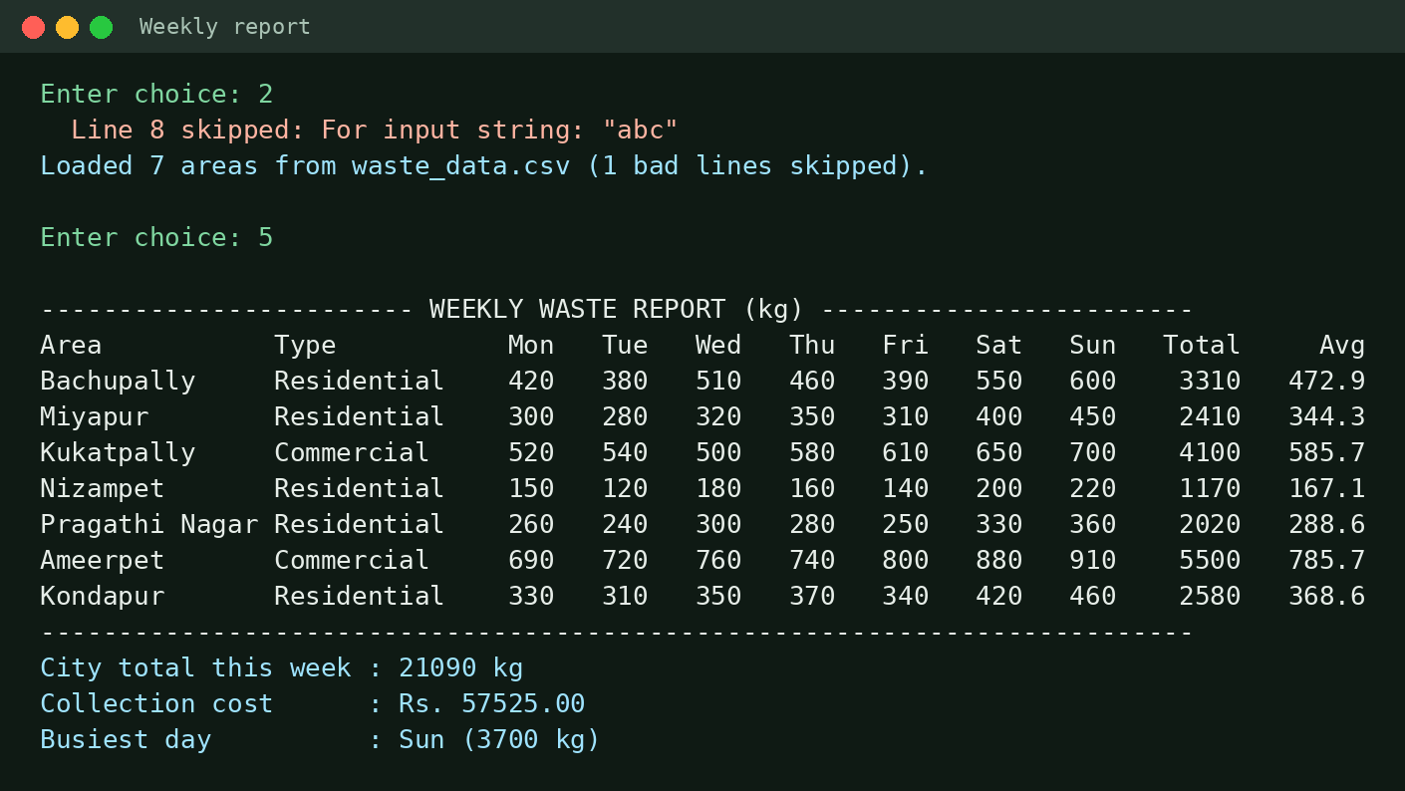
Screen Shots: Weekly Report
Loaded from waste_data.csv; report uses the 2D array, recursion and each type's own cost per kg
Notes:
This is the weekly report. First we loaded the data from the CSV file.
You can see that line 8 was skipped because it had "abc" instead of a number.
The table shows each area's waste for every day, with its total and average.
The city total for the week is 21,090 kg, the collection cost is 57,525 rupees, and Sunday is the busiest day.
The cost uses each area type's own rate, which is polymorphism from CO4.

Slide 12
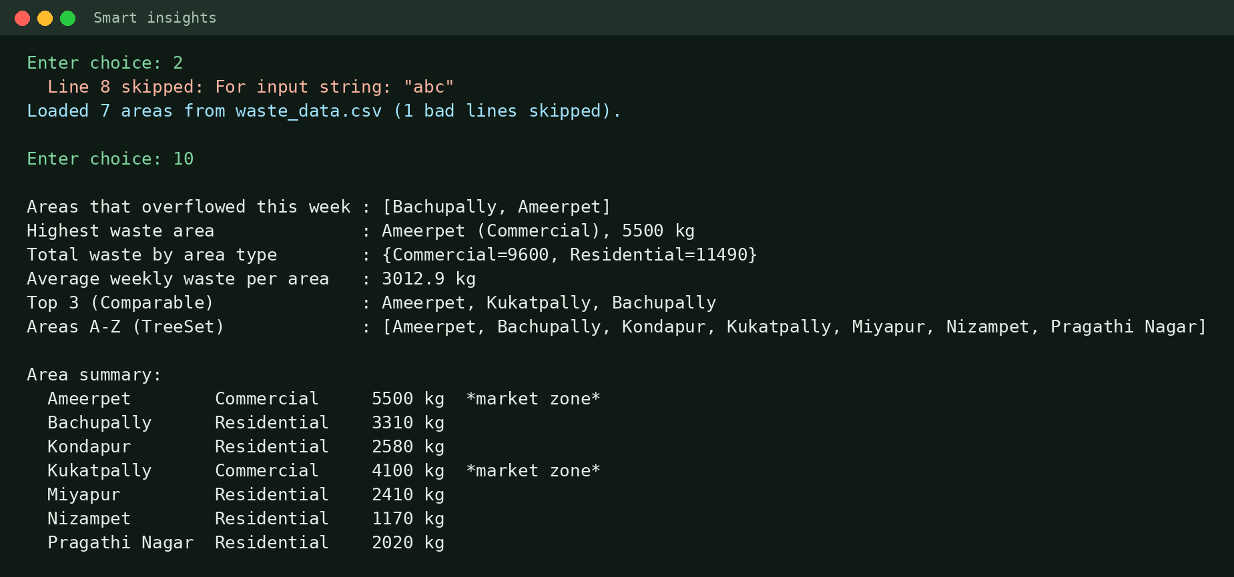
Screen Shots: Smart Insights
Option 10 uses streams, lambdas, Optional, groupingBy and a TreeSet
Notes:
This is the Smart Insights option, which uses CO6.
Bachupally and Ameerpet overflowed this week.
Ameerpet has the highest waste, 5,500 kg.
Commercial areas produced 9,600 kg and residential areas produced 11,490 kg.
The top 3 areas come from Comparable sorting, and the A to Z list comes from a TreeSet.

Slide 13
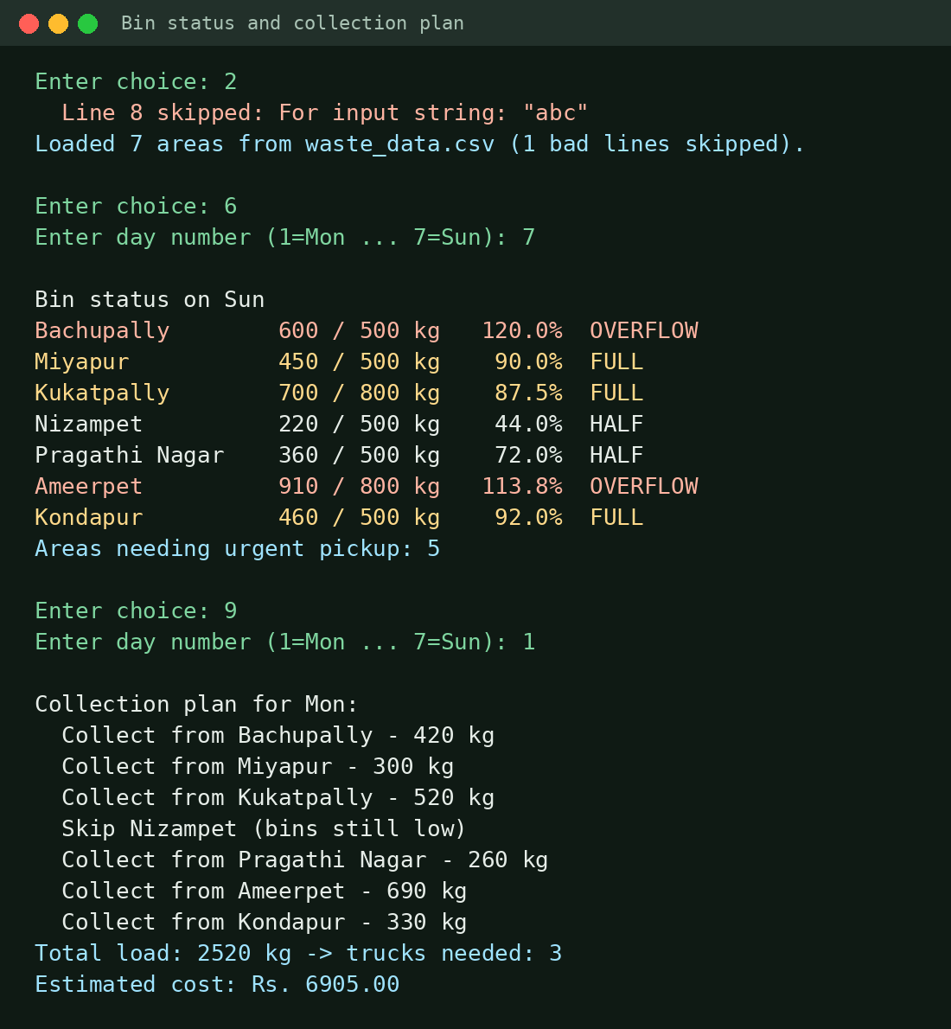
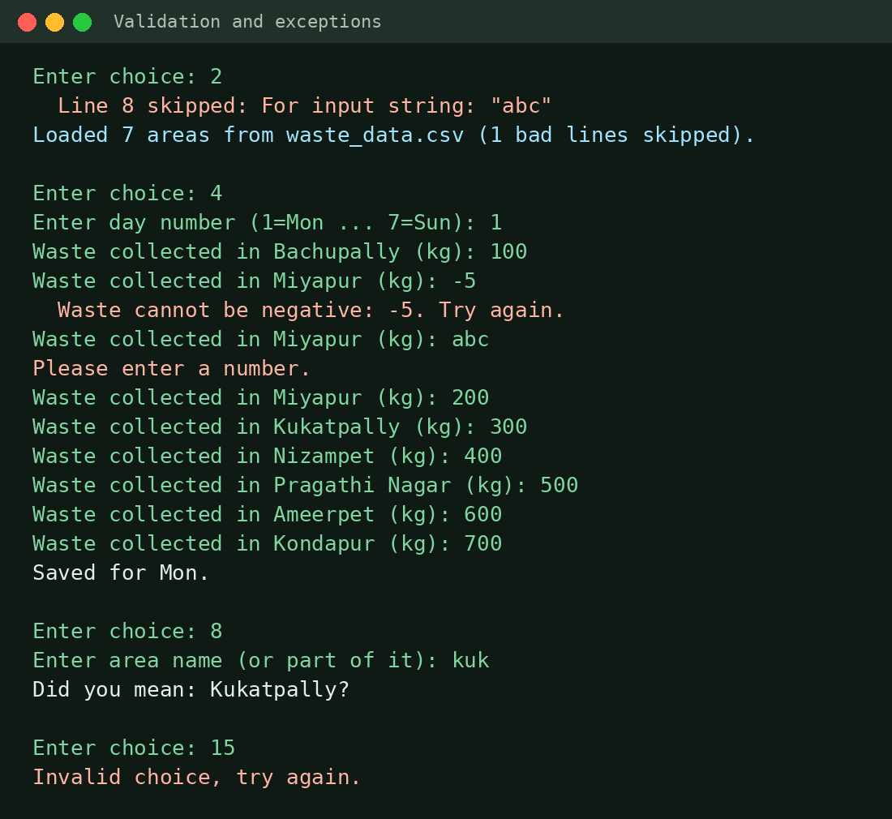
Screen Shots: Bin Status and Validation
Bin status for Sunday and collection plan for Monday
Bad CSV line, negative and non-numeric input handled
Notes:
On the left is the bin status for Sunday. Bachupally and Ameerpet are overflowing, and 5 areas need urgent pickup.
Below it is the Monday plan. Nizampet is skipped because its bins are low, and 3 trucks are needed.
On the right is our error handling.
A negative value shows our own exception message. Typing "abc" asks for a number again. A wrong menu choice shows "Invalid choice".
So the program never crashes on bad input.

Slide 14


Geo Tag Photo and GitHub Link
GitHub repository
github.com/eagabhavyansh-cloud/JavaPresentation
Contains:
Abstract (PDF)
WasteCollectionOptimiser.java
waste_data.csv (sample data file)
Paste geo-tagged photo here
taken during the review
Notes:
Our code, abstract and sample data file are on GitHub at this link.
This is our geo-tagged photo from today's review.
Thank you, ma'am. We are happy to answer any questions.

